Slide 1
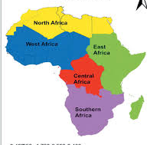
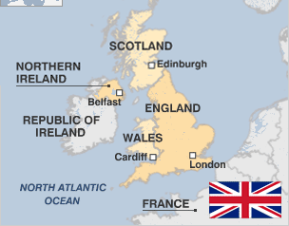
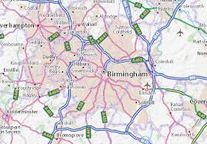
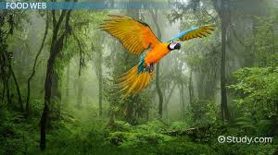
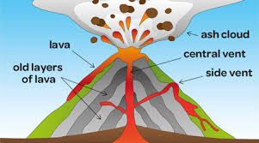
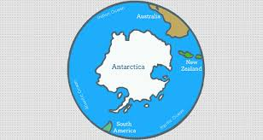
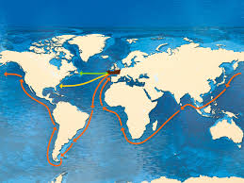
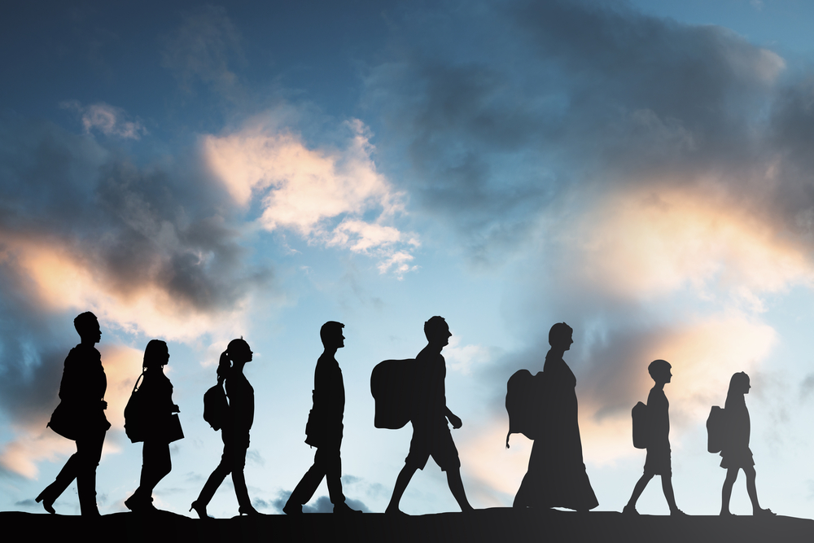
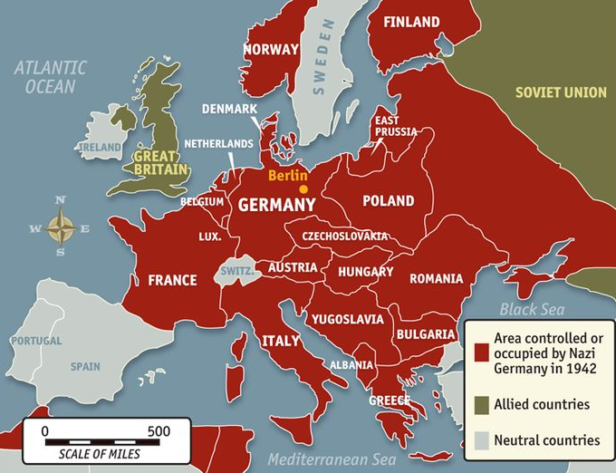
Year
One
On the Farm
Let’s Go
on Safari
Year
Two
United
Kingdom
Children will learn about the origins of the food they eat and how it is produced. They will visit a working farm as part of their studies.
Children will compare and contrast their own locality with examples of urban and rural localities in Kenya.
Through the topics of Fire and Plague and Dinosaurs children will learn about the United Kingdom, to include places, locations and key features.
Extreme
Earth
Year
Four
Birmingham
Amazonian
Rainforest
Year
Three
Through mapwork and a guided tour of the city centre the children will learn about human and physical features and how urban environments change to meet the changing needs of communities.
Children will learn about different ecosystems with a focus on rainforests. They will gain an appreciation of the environmental importance of rainforests and the threats they face.
Through the study of Ancient Greece they will learn about how landscape often determines where and why settlements are located
Year
Five
World
Exploration
Landscape & Settlement
Extreme Earth will focus on the continent of Antarctica, its landscape, climate and its ecological importance in the future sustainability of the Earth. It will also cover other naturally occurring events such as volcanoes..
Children will learn how our understanding of the world has changed over time. They will learn more about globalisation and trade and increase their knowledge of the diversity of the world in which they live. This will be done through a focus on Tudor exploration.
Through mapwork investigation, children will increase their knowledge and understanding of Europe as a continent and how world events, such as war, can change the political landscape.
Children will gain an understanding of the different reasons for human migration and how this impacts on individuals, communities and countries.
Human
Migration
Europe and
Political Change
Year
Six
Colmers Primary School Curriculum Road Map - Geography

