Slide 1



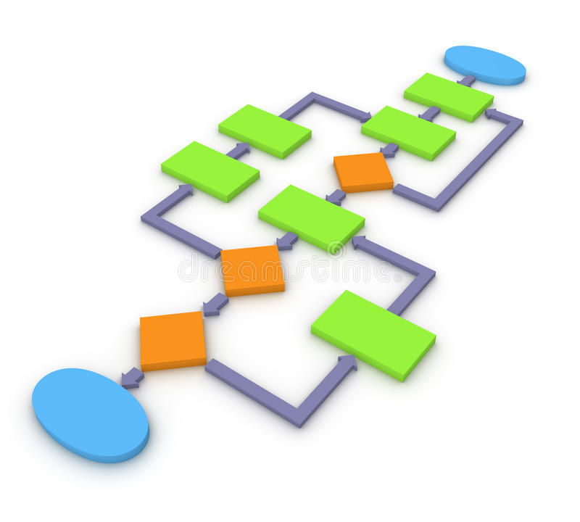






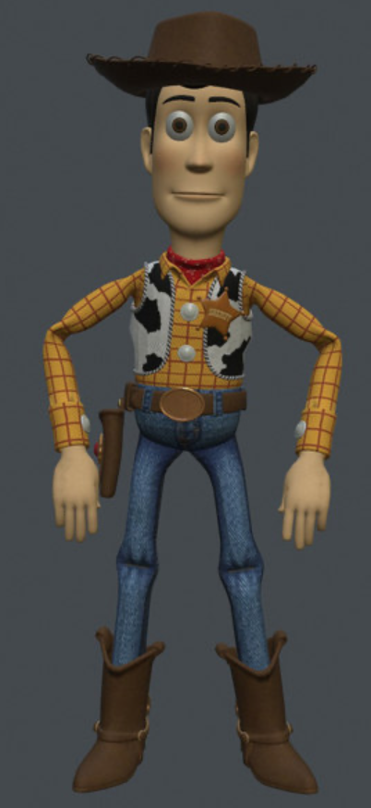


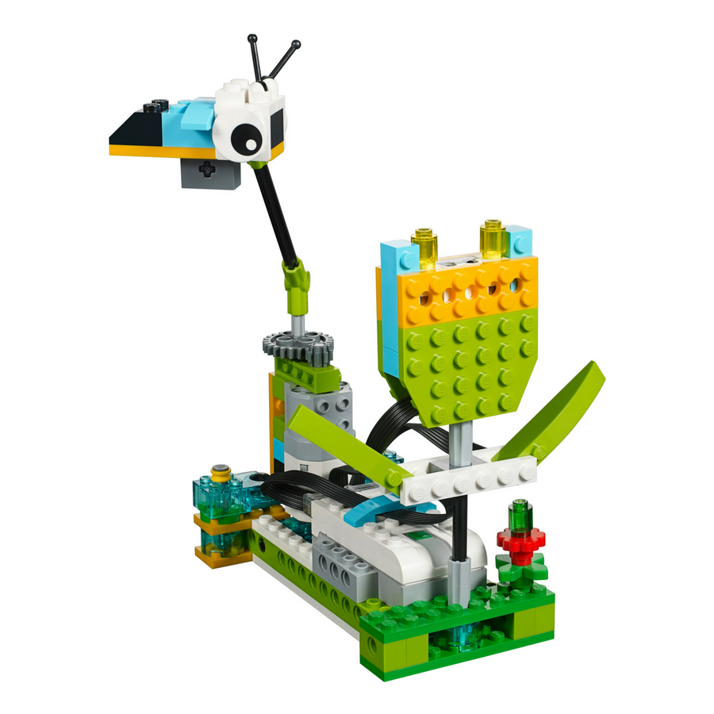










E-SAFETY
ALGORITHMS
WORD PROCESSING
DATA REPRESENTATION
PROGRAMMING
MODELLING
PROGRAMMING
E-SAFETY
PROGRAMMING WITH SCRATCH
Year
One
Year
Two
WEB SEARCHING
DATA REPRESENTATION
COMPUTER NETWORKS
PROGRAMMING WITH LEGO WEDO
PROGRAMMING
PUBLISHING
E-SAFETY
BLOGGING
THE WWW - CONNECTING
Year Three
ANIMATION
E-SAFETY
PROGRAMMING
DATABASES
PROGRAMMING WITH LEGO WEDO
ANIMATION
PROGRAMMING
E-SAFETY
PROGRAMMING
Year
Four
GRAPHIC
DESIGN
Year Five
AI
DEVELOPING APPS
COMPUTER NETWORKS
PROGRAMMING
MODELLING
SPREADSHEETS
E-SAFETY
Year
Six
CRYPTOGRAPHY
Colmers Farm Primary School Curriculum Road Map – Computing
THE WWW

